Slide 1


البنى البلورية للمواد الهندسية والمعادن
Crystal Structure of
Engineering Materials
Presented by
Prof. Dr. Adel K. Mahmoud
Full Professor in
Materials Engineering Department
College of Engineering;
University of Diyala
Iraq

Slide 2
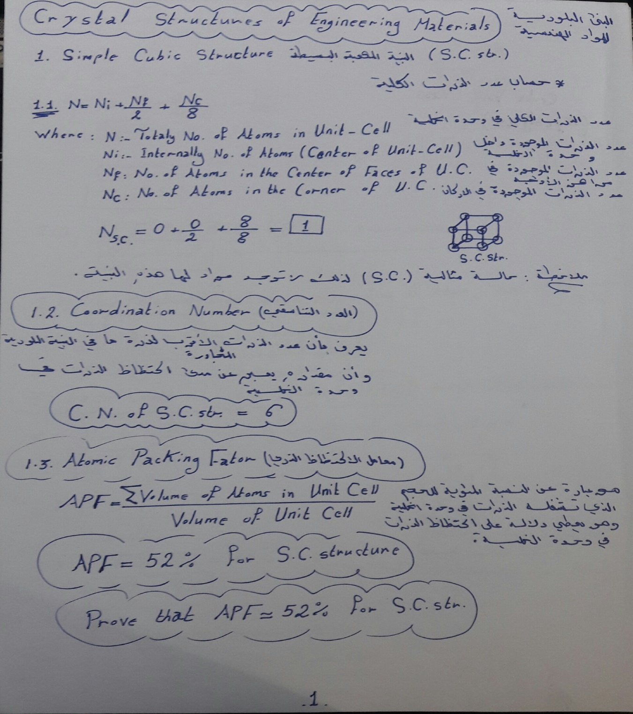

Slide 3
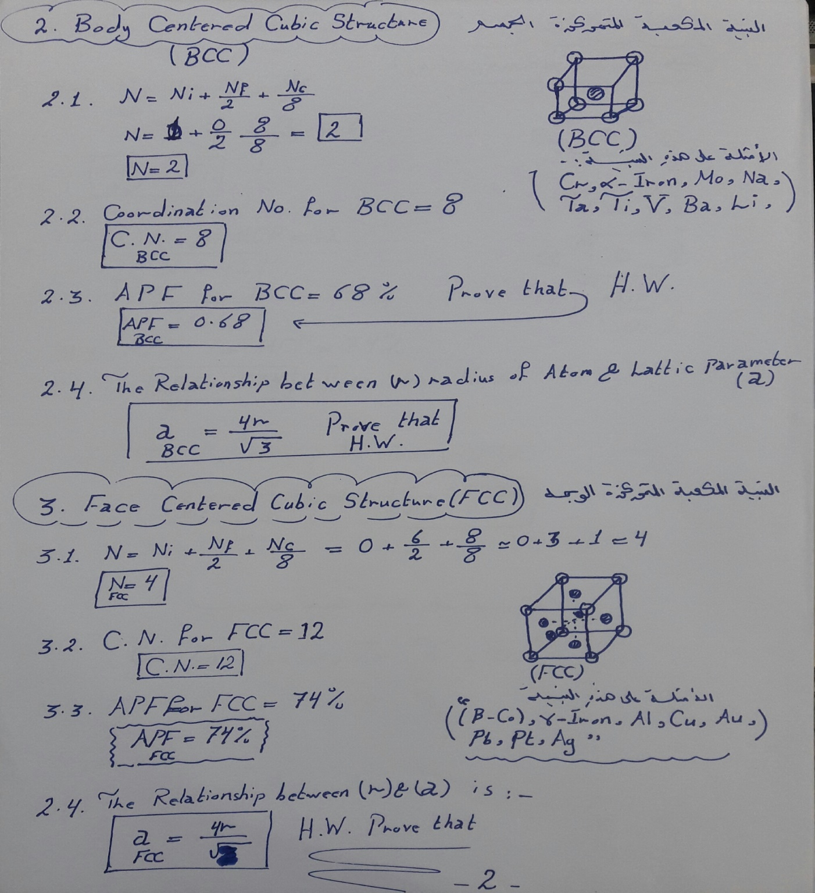

Slide 4
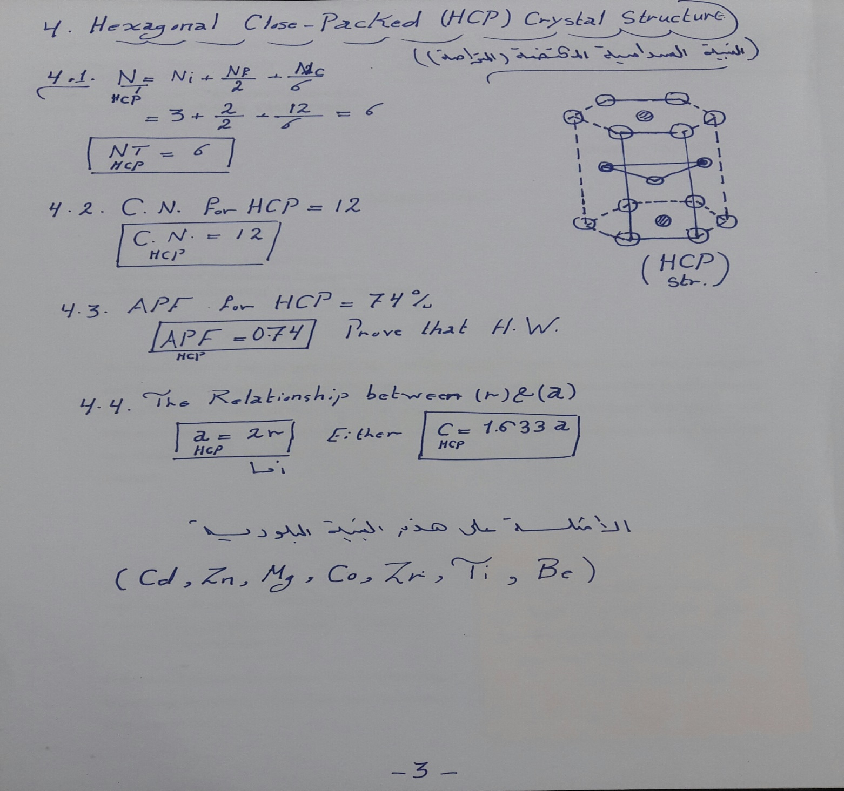

Slide 5
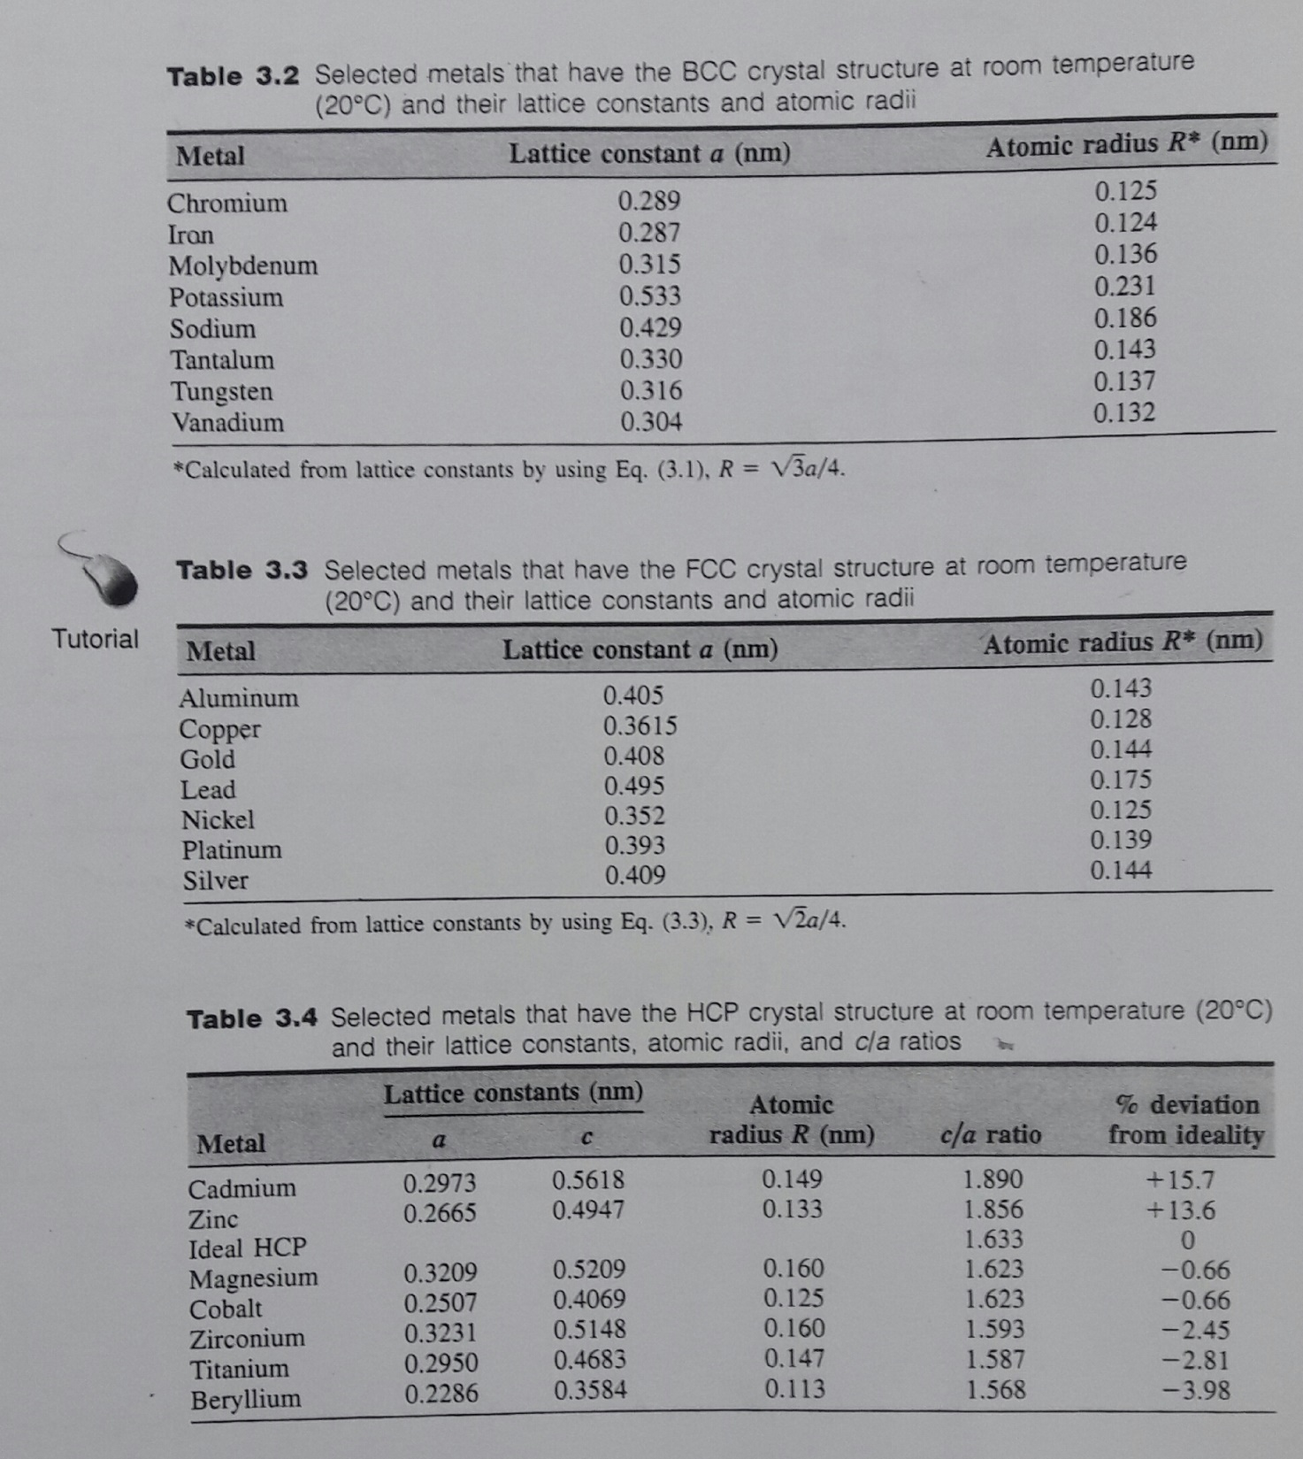

Slide 6
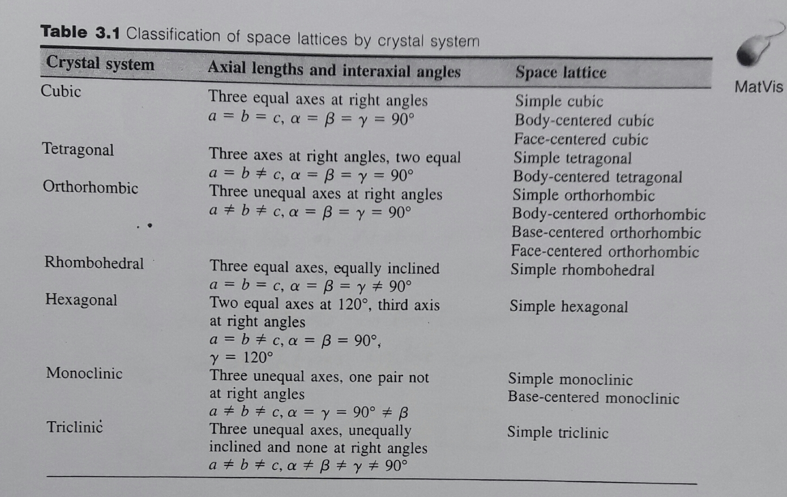

Slide 7
Thanks for Your Attention

